Slide 1
Deutsche Bank Partners with Skillsoft - Global Knowledge
Enterprise-grade learning solutions serving 3,000+ organizations and ~149M learners worldwide
Premium instructor-led training provider, known worldwide for technology learning

Slide 2
DB Training Program
Welcome to Day 1 - Graduate development programme.
DB at the Graduate Orientation -Pune

Slide 3
DB Training Program
Region - India, EMEA and the US
10 days training plan + 3 code challenge
Cover any housekeeping including
a) being punctual
b) on camera as much as possible
c) report any tech issues immediately to the IT helpdesk – numbers have been provided via the grad app on Friday 18th July.

Slide 4
Programme Tracks
Foundational
Intermediate
Intermediate Hybrid
This Foundation Track is designed to provide learners with a strong grounding in full-stack web development. The course starts with the fundamentals of front-end technologies—HTML, CSS, JavaScript, and React.js—enabling learners to create dynamic, responsive user interfaces.
Key Technologies Covered:
Frontend: HTML, CSS, JavaScript, React.js
Backend: Java, Spring Boot
Database: PostgreSQL
This comprehensive intermediate-level course is designed to empower learners with the practical skills required to build robust full-stack web applications. Starting with front-end development, participants will explore the fundamentals of creating dynamic, responsive user interfaces using HTML, CSS, JavaScript, and React.js.
Key Technologies Covered:
Frontend: HTML, CSS, JavaScript, React.js
Backend: Java, Spring Boot
Database: PostgreSQL
DevOps: Docker, GitHub Actions (CI/CD)
Real-world hands-on projects throughout
This Intermediate Hybrid track hands-on course is designed for learners aiming to master full-stack web development using modern tools and best practices. The curriculum begins with front-end development using HTML, CSS, JavaScript, and React.js, enabling learners to build responsive and dynamic user interfaces.
Key Highlights:
Frontend: HTML, CSS, JavaScript, React.js
Backend: Advanced Java & Spring Boot with testing and performance tuning
Database: PostgreSQL
DevOps: CI/CD with Docker & GitHub Actions
Strong focus on hands-on projects and practical implementation

Slide 5







Intermediate Track Learning Path
Day 1
Day 2
Day 3
Day 4
Day 5
Introduction to Relational Databases & PostGreSQL
PostgreSQL Advanced Concepts
JAVA Module 1
JAVA Module 2
JAVA Module 3
JAVA Module 4
JAVA Module 5
JAVA Module 6
Unveiling Spring Boot & Building Your First Application
Unveiling Spring Boot & Building Your First Application
Day 6
Day 7
Day 8
Day 9
Day 10
Advanced Spring Boot Features & Building RESTful APIs
Advanced Spring Boot Features & Building RESTful APIs
HTML
Cascading Stylesheets (CSS) & Web Design Principles
Introduction to JavaScript
Foundations of ReactJS
Foundations of ReactJS
Deep Dive into ReactJS Components & Advanced Concepts
Docker Essentials
CICD
Intermediate Track Synopsis
Intermediate Track Prerequisites
This comprehensive intermediate-level course is designed to empower learners with the practical skills required to build robust full-stack web applications. Starting with front-end development, participants will explore the fundamentals of creating dynamic, responsive user interfaces using HTML, CSS, JavaScript, and React.js.
The journey continues with back-end development using Java and Spring Boot. Learners will gain hands-on experience in designing and implementing secure, scalable RESTful APIs, alongside integrating PostgreSQL for efficient data storage and retrieval
Basic Familiarity of web applications and the need for them.
Familiarity with database concepts like tables, schemas etc.
Fundamental Understanding of normalization, ACID properties, and SQL syntax.
Awareness of source control (e.g., Git)

Slide 6
PostgreSQL

Slide 7
Agenda
1
Introduction to PostgreSQL
2
Key Features of PostgreSQL
3
Basic Table Design Principles
4
What is Normalization
5
Types of Relationships
6
SELECT, Data Modification Commands, Aggregate Functions, Subqueries

Slide 8
Agenda
1
Understanding Joins and Indexes
2
Creating and Querying Views
3
Working with Built-in Functions
4
Writing Custom Functions in PL/pgSQL
5
Triggers, Transactions, and Roles

Slide 9
What is Postgres SQL?
PostgreSQL (pronounced "post-gress-Q-L") is a powerful, open-source, object-relational database management system (ORDBMS) that emphasizes extensibility, data integrity, and standards compliance. It is designed to handle a wide range of workloads, from small single-machine applications to large Internet-facing applications with many concurrent users.

Slide 10
What is use of PostgreSQL?
Data Storage: It stores data in an organized way using tables, making it easy to manage large amounts of information.
Complex Queries: PostgreSQL supports complex queries, allowing you to fetch specific data using SQL (Structured Query Language).
ACID Compliance: It ensures reliable transactions with ACID (Atomicity, Consistency, Isolation, Durability) compliance, meaning your data remains accurate and secure.
Scalability: Suitable for both small and large applications, PostgreSQL can handle a large number of users and large datasets.
Extensibility: You can add custom functions, data types, and extensions, making PostgreSQL highly flexible and adaptable to various needs.
Support for Advanced Data Types: It supports advanced data types like JSON, XML, and arrays, allowing for diverse data storage and manipulation.

Slide 11

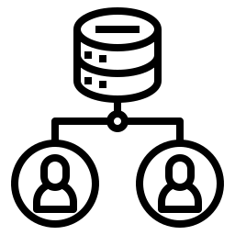
What is PostgreSQL?
Open-source
Object-relational database system

Slide 12
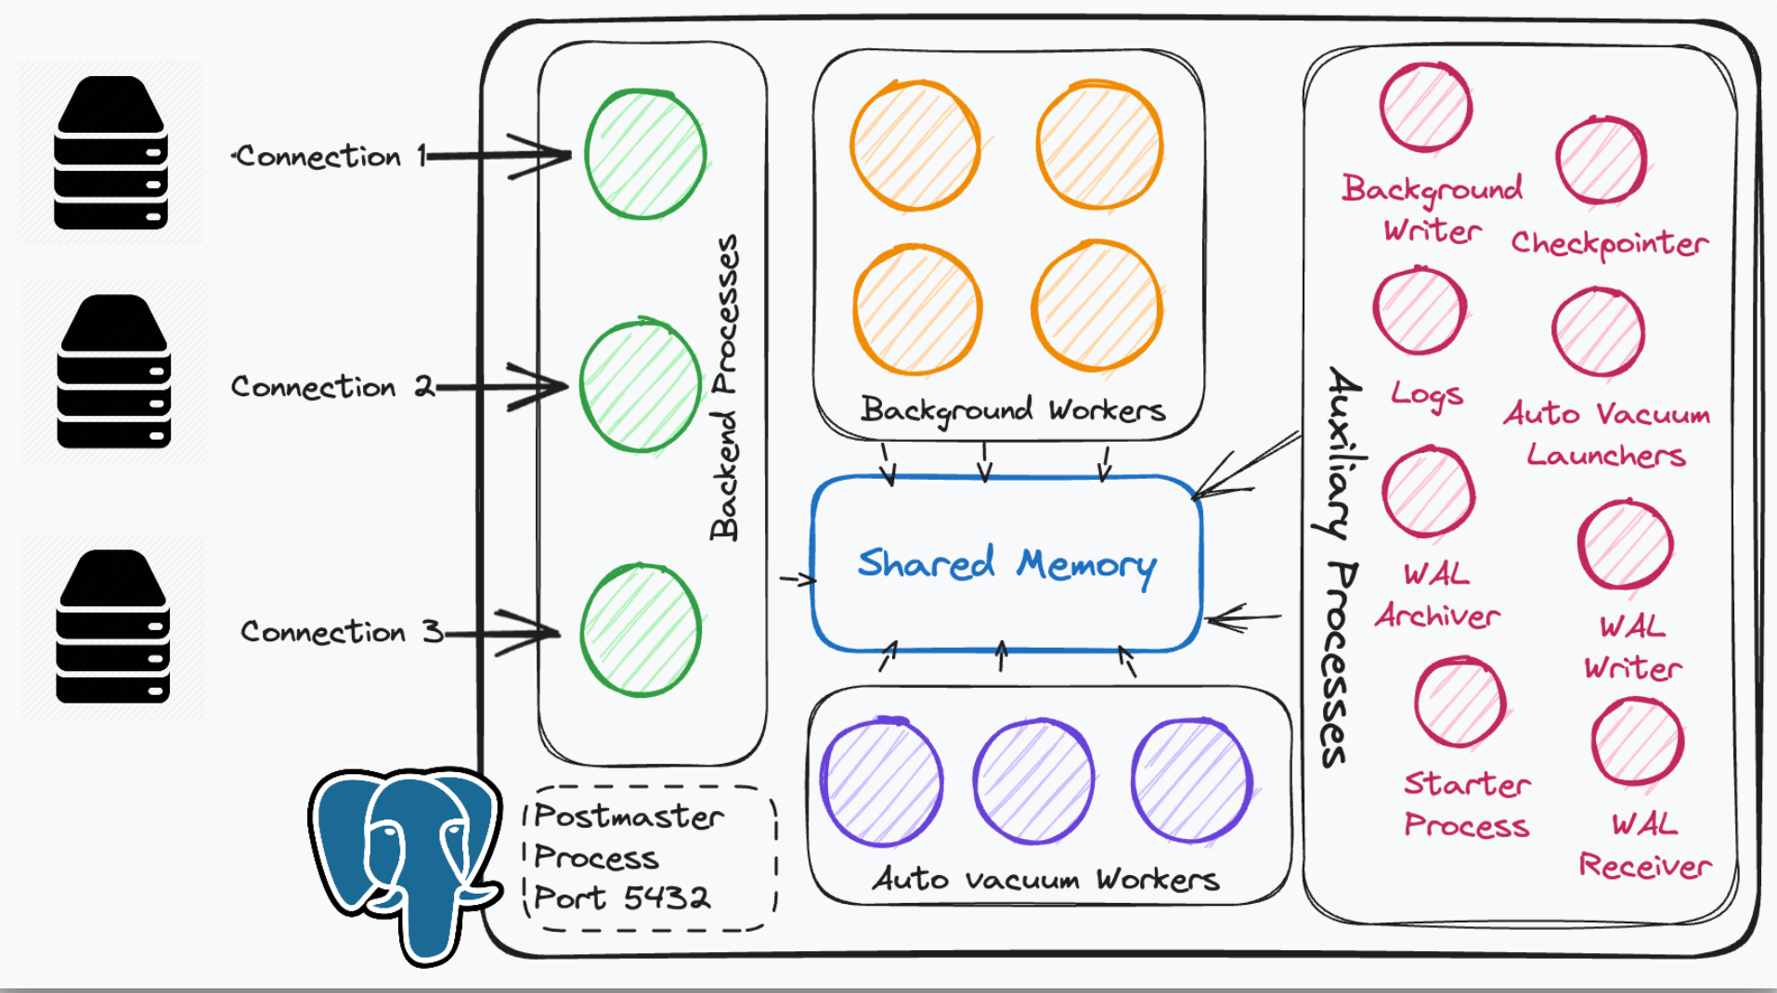
PLSQL Architecture

Slide 13
PostgreSQL Architecture at a Glance
1. Client Interface
Users or applications connect via tools like psql, JDBC, or PgAdmin.
They send SQL queries over TCP/IP to PostgreSQL.
2. Postmaster (Main Server Process)
Listens for connections from clients.
Spawns a new backend process for each client connection.
3. Backend Process
A separate process handles each client.
Responsible for parsing, planning, execution, and returning results.
4. Shared Memory Buffers
A memory area accessible to all backend processes.
Stores frequently accessed data (caching) to reduce disk I/O.
5. WAL (Write-Ahead Logging)
Ensures data durability and crash recovery.
All changes are first written to a log file before being applied to the database.
6. Background Processes
Examples:
Checkpointer: Flushes changes from memory to disk.
Autovacuum: Reclaims storage from deleted/updated rows.
WAL Writer: Writes WAL data to disk.

Slide 14
Auxiliary Processes
Auxiliary processes are secondary or supplementary processes that perform various tasks to support the core functionality of the Postgres system. There are multiple auxiliary processes that are running in the background.

Slide 15



Key Features of PostgreSQL
Extensibility
Add data types, operators, functions
ACID Compliance
Atomicity, Consistency, Isolation, Durability
JSON & JSONB
Efficient storage, indexing, and querying of semi-structured data

Slide 16
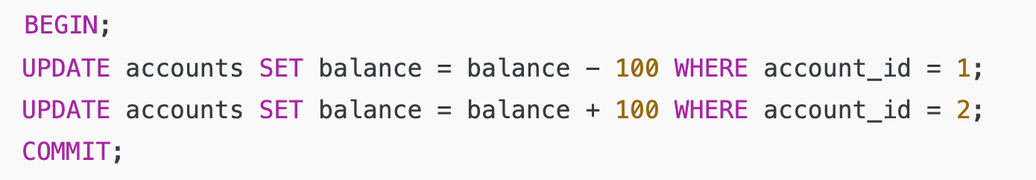
ACID- Atomicity
"All or nothing"
A transaction must be fully completed or not executed at all.
If any part fails, the entire transaction is rolled back.

Slide 17
ACID - Consistency
"Valid state transitions"
The database must move from one valid state to another.
Enforces constraints, foreign keys, triggers, etc.
Example:
You can't insert a row with a foreign key that doesn't exist.

Slide 18
ACID - Isolation
"Concurrent transactions don't interfere"
Each transaction is isolated from others.
Prevents issues like dirty reads, non-repeatable reads, or phantom reads.
PostgreSQL supports multiple isolation levels like:
Read Committed
Repeatable Read
Serializable

Slide 19
ACID - Durability
"Once committed, it stays"
After a transaction is committed, its changes are permanent, even in case of a crash or power failure.
The database uses WAL (Write-Ahead Logging) to ensure this.

Slide 20
PostgreSQL vs Other RDBMS
Feature | PostgreSQL | MySQL | Oracle
Licensing | Open Source | Open Source | Commercial
JSONB Support | Yes | Limited | Yes (JSON only)
Extensibility | High | Moderate | Moderate
Standards Compliance | Very High | Moderate | High

Slide 21
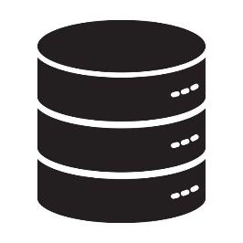



What is a Database in PostgreSQL?
A database is a container for tables, views, indexes, functions, etc.
PostgreSQL can host multiple databases under a single server instance.
A schema is like a folder inside a database — it helps organize database objects (tables, functions, etc.)
A role can be a user or a group.You can control who can create databases, access specific schemas, or run queries.

Slide 22
What is Table Design?
Tables are the core structures in a database that store data.
Each table is made of columns (fields) and rows (records).
Good table design ensures:
Consistency
Flexibility
Easy maintenance
Example SQL query for creating table
CREATE TABLE students (
student_id SERIAL PRIMARY KEY,
name TEXT NOT NULL,
email TEXT UNIQUE,
birthdate DATE
);

Slide 23


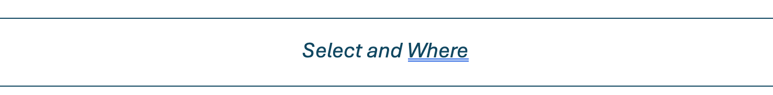
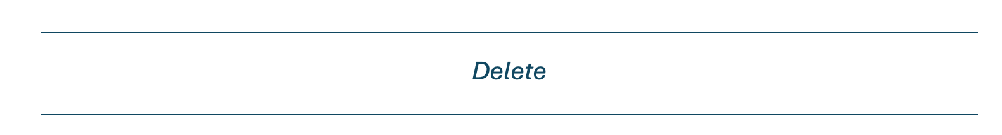
Basic Table Design Principles
Choose meaningful table names (e.g., students, orders, products).
Use proper data types (e.g., INTEGER, TEXT, DATE) for each column.
Include a Primary Key (a unique identifier for each row).
Avoid storing multiple values in one column (no comma-separated values).
1
2
3
4

Slide 24
Data Modification Commands
1
2
3
INSERT INTO table (...) VALUES (...)
Example
INSERT INTO students (name, age)
VALUES ('Anya', 20);
UPDATE table SET column = value WHERE condition
Example
UPDATE students
SET age = 21
WHERE name = 'Anya';
DELETE FROM table WHERE condition
Example
DELETE FROM students
WHERE age < 18;
*Without WHERE, UPDATE and DELETE will affect all rows.

Slide 25
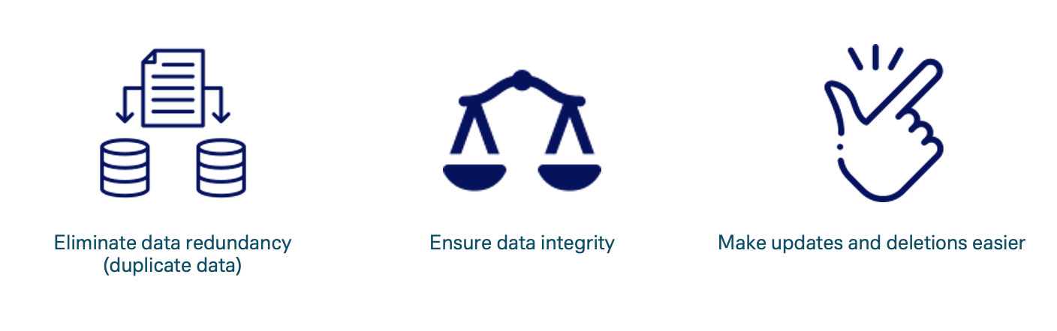
What is Normalization?

Slide 26
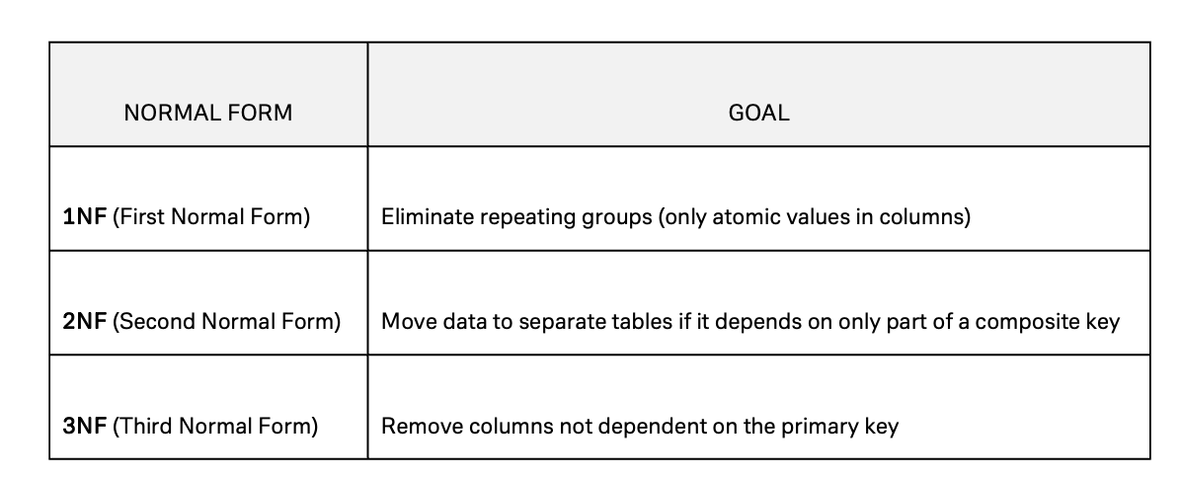
Common Normal Forms

Slide 27
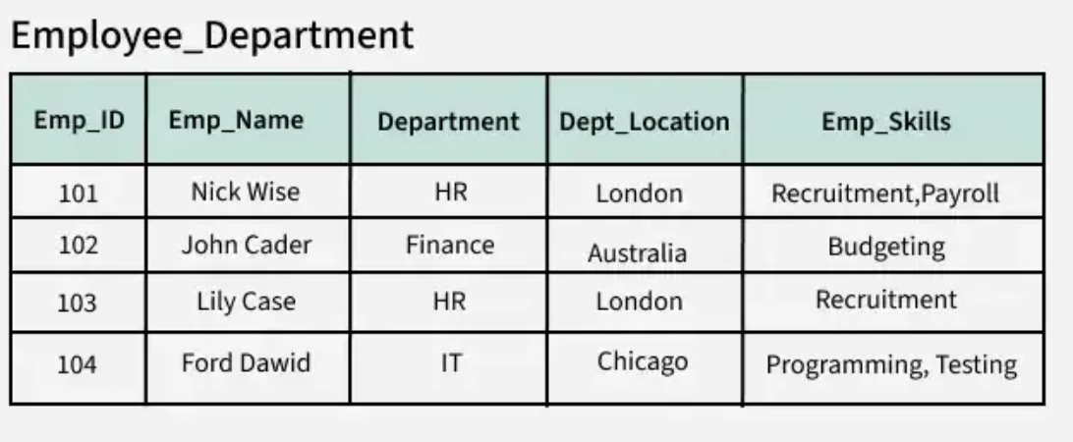
BEFORE

Slide 28
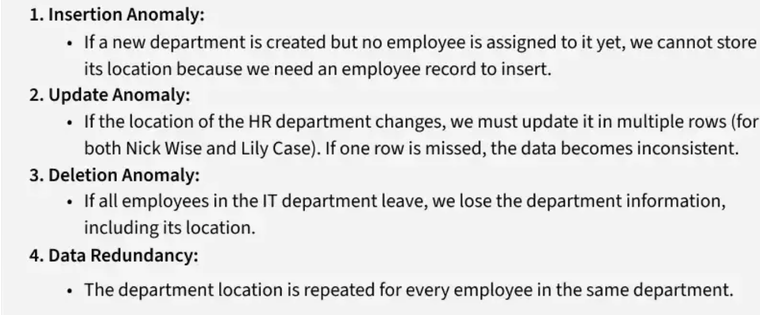
PROBLEMS

Slide 29
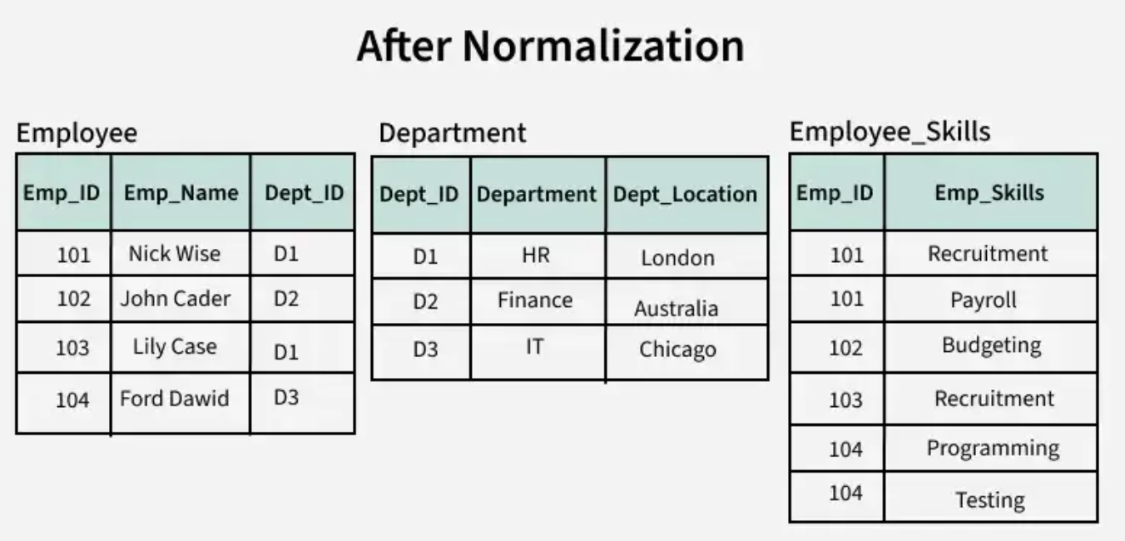
AFTER

Slide 30
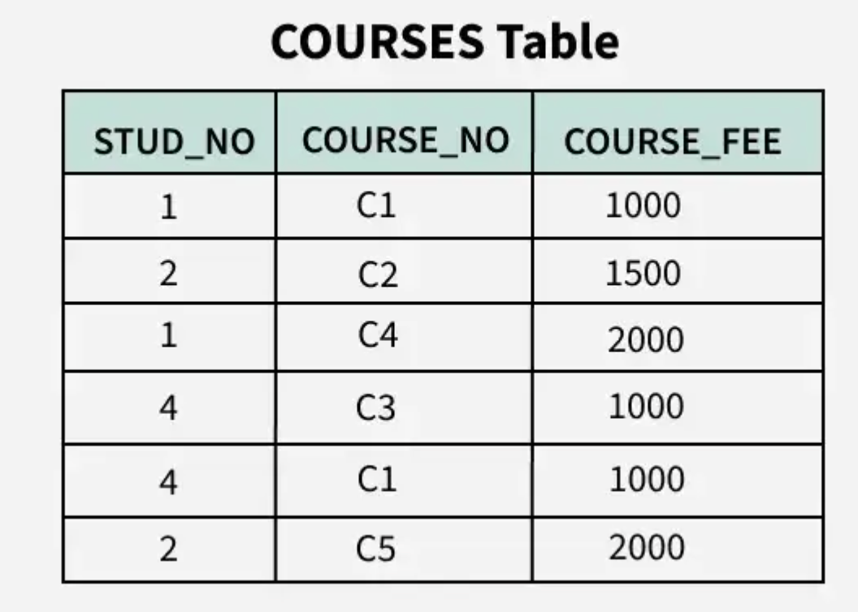
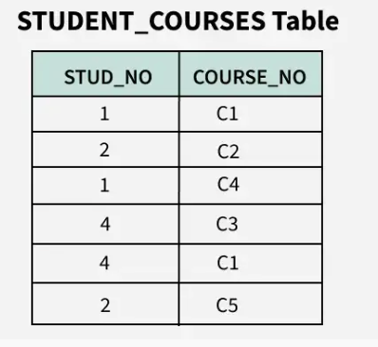
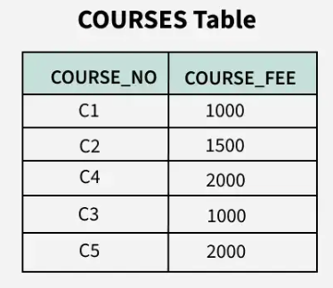
2 NF

Slide 31
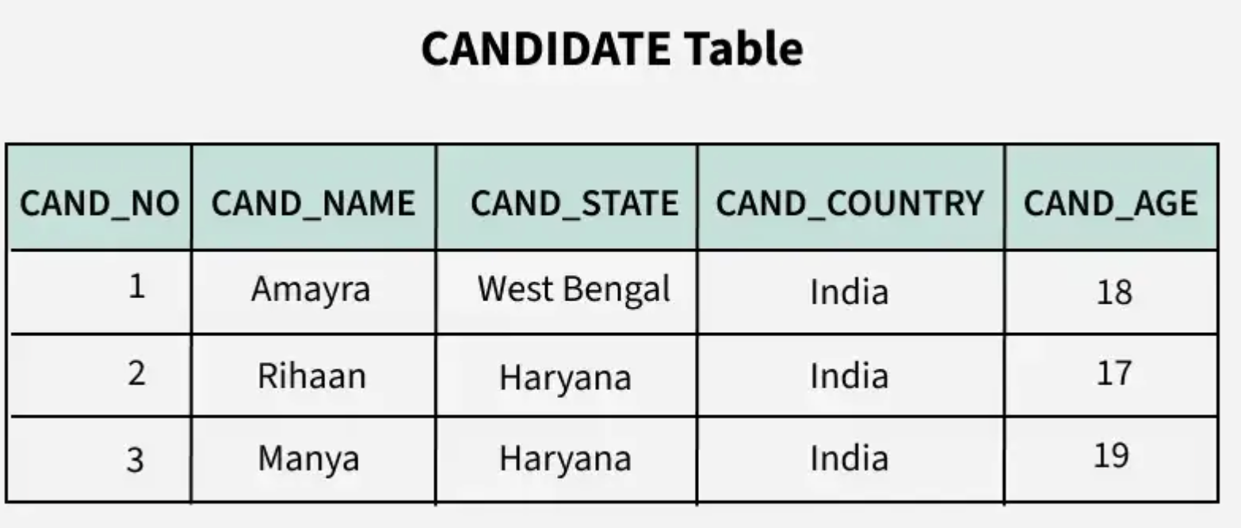
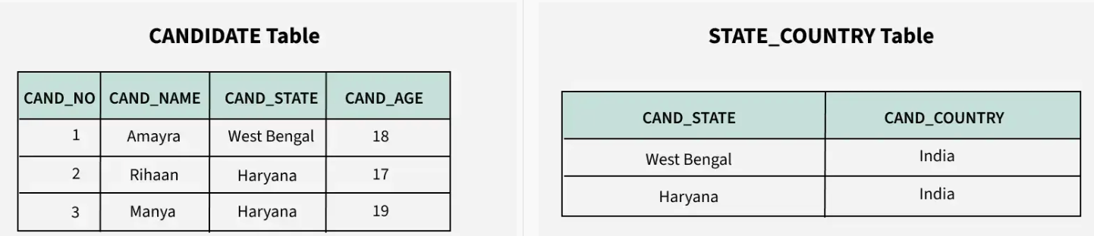
3 NF

Slide 32
Example (Before & After Normalization)
Table
Orders(order_id, customer_name, product1, product2, ...)
Normalized
Table
Table
Customers(customer_id, customer_name)
Orders(order_id, customer_id)
Order_Items(order_id, product_id)
Table

Slide 33
PostgreSQL Data Types Deep Dive
1
Numeric: INTEGER, SERIAL, NUMERIC
2
Textual: TEXT, VARCHAR(n)
3
Temporal: DATE, TIMESTAMP
4
JSONB: Binary JSON for performance
5
Boolean: TRUE, FALSE

Slide 34

Constraints in PostgreSQL
1
Primary Key: Unique, not null identifier
ALTER TABLE students ADD PRIMARY KEY (student_id);
2
Foreign Key: References another table
ALTER TABLE orders ADD CONSTRAINT fk_customer
FOREIGN KEY (customer_id) REFERENCES customers(customer_id);
3
UNIQUE
ALTER TABLE employees ADD CONSTRAINT unique_email
UNIQUE (email);
4
NOT NULL
ALTER TABLE products
MODIFY COLUMN price DECIMAL(10,2) NOT NULL;
5
CHECK(condition)
ALTER TABLE students ADD CONSTRAINT check_age
CHECK (age >= 18);

Slide 35


Entity Relationship Mapping
Primary Key (PK): Uniquely identifies each record in a table
Example: student_id in the students table
Foreign Key (FK): A field in one table that refers to the primary key in another table
→ Used to establish relationships

Slide 36
Types of Relationships
Relationship Type | Description | Example
One-to-One | One record in Table A is related to one in Table B | Employee ↔ ParkingSpot
One-to-Many | One record in Table A is related to many in Table B | Department → Employees
Many-to-Many | Many records in Table A relate to many in Table B | Students ↔ Courses

Slide 37
SQL Fundamentals

Slide 38
What is SELECT?
The SELECT statement is used to query data from a table.
You can choose to select all columns or specific ones
Using WHERE to Filter Rows
SELECT name FROM students
WHERE age > 18;
SELECT column1, column2 FROM table_name;
Sorting with ORDER BY
LIMIT and OFFSET
SELECT name, age FROM students
ORDER BY age DESC;
SELECT * FROM students ORDER BY student_id
LIMIT 5 OFFSET 10;

Slide 39

Built-in Functions - String Functions in PostgreSQL
Function | Description | Example | Result
LENGTH(str) | Returns number of characters | LENGTH('hello') | 5
LOWER(str) | Converts to lowercase | LOWER('Postgres') | postgres
UPPER(str) | Converts to uppercase | UPPER('sql') | SQL
INITCAP(str) | Capitalizes first letter of each word | INITCAP('hello world') | Hello World
CONCAT(a, b) | Joins strings | CONCAT('foo', 'bar') | foobar
SUBSTRING(str FROM start FOR length) | Extracts part of a string | SUBSTRING('PostgreSQL' FROM 1 FOR 4) | Post
TRIM(str) | Removes spaces from both ends | TRIM(' data ') | data
REPLACE(str, from, to) | Replaces text | REPLACE('abcabc', 'a', 'x') | xbcxbc

Slide 40
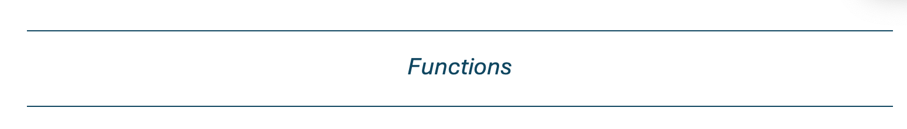
What Are Aggregate Functions?
Aggregate functions perform calculations on multiple rows of a table and return a single value.
Function | Purpose | Example
COUNT() | Counts rows | COUNT(*) counts all
SUM() | Adds values | SUM(price)
AVG() | Average of values | AVG(score)
MIN() | Smallest value | MIN(age)
MAX() | Largest value | MAX(salary)
Examples
SELECT COUNT(*) FROM students; -- Returns the number of students
SELECT AVG(age) FROM students; -- Returns the average age

Slide 41

Built-in Functions - Date Functions in PostgreSQL
Function | Description | Example | Result
CURRENT_DATE | Returns today’s date | SELECT CURRENT_DATE; | 2025-06-16
CURRENT_TIMESTAMP | Returns current date and time | SELECT CURRENT_TIMESTAMP; | 2025-06-16 14:23:45.123
AGE(date) | Calculates time difference from now | AGE('2000-01-01') | 25 years ...
EXTRACT(field FROM date) | Extracts part of the date | EXTRACT(YEAR FROM CURRENT_DATE) | 2025
NOW() | Same as CURRENT_TIMESTAMP | SELECT NOW(); | 2025-06-16 14:23:45.123
DATE_TRUNC('field', timestamp) | Rounds to start of unit | DATE_TRUNC('month', NOW()) | 2025-06-01 00:00:00
TO_CHAR(date, format) | Formats date into string | TO_CHAR(NOW(), 'YYYY-MM-DD') | 2025-06-16
INTERVAL | Represents time span | NOW() + INTERVAL '7 days' | 2025-06-23 ...

Slide 42
Aliasing in SQL
Aliasing gives a temporary name to a table or column to make SQL queries shorter or more readable.
Column Alias
Table Alias
SELECT column_name AS alias_name FROM table_name;
SELECT s.name, d.name
FROM students AS s
JOIN departments AS d ON s.dept_id = d.id;
Example of Column Alias
You can even skip the “AS” keyword
SELECT name AS student_name, age AS student_age
FROM students;
--- FROM students s JOIN departments d ...

Slide 43
What is a JOIN?
To combine data from two or more tables based on a related column.
Student Table
Dept. Table
Sample Join Query
SELECT s.name, d.name AS department FROM students s
JOIN departments d ON s.dept_id = d.id;
To find each student’s department name, you JOIN them on the dept_id.

Slide 44
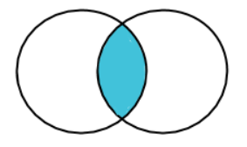
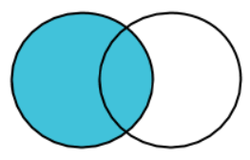
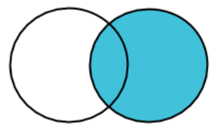
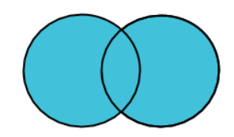

Types of Joins in PostgreSQL
INNER JOIN: Match rows in both tables
LEFT JOIN: All rows from left + matched rows from right
RIGHT JOIN: All rows from right + matched rows from left
FULL JOIN: All rows from both tables, with NULLs where no match

Slide 45
Self Join & Cross Join
Self Join: Join a table with itself (e.g., employee → manager)
Cross Join: Cartesian product of two tables
Self Join
Table A
Table B
Table A
Example
Example
SELECT e1.name, e2.name AS manager
FROM employees e1
JOIN employees e2 ON e1.manager_id = e2.id;
SELECT s.name, c.course_name
FROM students s
CROSS JOIN courses c;

Slide 46
Using Aliases and Subqueries in Joins
Aliases
Simplify table references (AS)
Subqueries
Use in FROM, SELECT, or WHERE
Example
SELECT e.name, d.avg_salary
FROM employees e
JOIN (
SELECT dept_id, AVG(salary) AS avg_salary
FROM employees
GROUP BY dept_id
) d ON e.dept_id = d.dept_id;

Slide 47
Join Summary
Join Type | Matching Rows | Non-Matching Rows
INNER | ✅ | ❌
LEFT | ✅ (left) | NULLs from right
RIGHT | ✅ (right) | NULLs from left
FULL | ✅ | NULLs from both

Slide 48
Creating and Querying Views
A view is a virtual table in PostgreSQL.
It’s a saved SQL query that you can treat like a regular table.
Creating Views
Querying View with select statement
CREATE VIEW active_employees AS
SELECT * FROM employees WHERE status = 'active';
SELECT * FROM active_employees
Key Points
It does not store data itself, just the SQL logic.
When you query a view, PostgreSQL runs the underlying SELECT statement.
Useful for simplifying complex queries, hiding sensitive columns, or providing read-only access.

Slide 49



When & Why to Use Views
Abstract complex queries
Enhance security (restrict columns)
Simplify reporting

Slide 50
What is an Index?
It helps PostgreSQL find data faster
Without an index, PostgreSQL scans every row (called a sequential scan)
301
ABR | 201
KPV | 202
… | …
… | …
201
202
ABR | 101
KPV | 102
… | 103
… | …
KVP | 104
ORD | 105
… | 106
… | …
101
102
103
104
105
106
ABR | 1
KPV | 18
… | …
… | …
AZO | 13
BFF | 16
… | …
… | …
COD | 19
IPL | 11
… | …
… | …
KPV | 15
KQA | 4
… | …
… | …
ORD | 9
OXR | 17
… | …
… | …
RDU | 10
RSW | 12
… | …
… | …

Slide 51



Why Use Indexes?
Faster SELECT queries
Boosts JOIN performance
Speeds up WHERE, ORDER BY, LIMIT
Useful for full-text search, range queries,
and filtering on JSONB fields

Slide 52

Creating an Index
Syntax
CREATE INDEX index_name ON table_name (column_name);
Sample query
CREATE INDEX idx_students_age ON students(age);

Slide 53

EXPLAIN & ANALYZE
EXPLAIN shows the query plan
ANALYZE adds actual execution time.
Sample query
EXPLAIN ANALYZE SELECT * FROM students WHERE age > 20;
Output
Seq Scan on students (cost=0.00..35.50 rows=500 width=64)
Filter: (age > 20)
Rows Removed by Filter: 100
-> Actual rows: 500 loops: 1
Planning Time: 0.125 ms
Execution Time: 1.234 ms

Slide 54
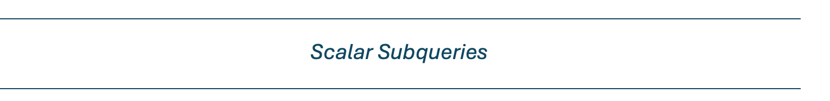
Nested Queries (Subqueries)
A subquery is a query inside another query.
It can be used in the SELECT, FROM, or WHERE clause.
The inner query runs first and passes results to the outer query.
Subquery in WHERE
SELECT name FROM students
WHERE dept_id = (
SELECT id FROM departments
WHERE name = 'Computer Science'
);
Subquery in FROM (Derived Table)
SELECT avg_age FROM (
SELECT AVG(age) AS avg_age FROM students
) AS stats;

Slide 55
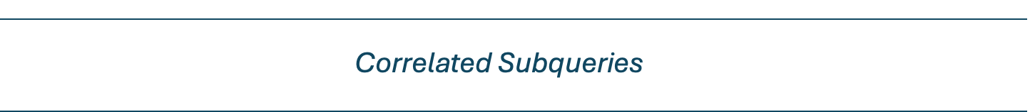
Correlated Subqueries
A correlated subquery is a subquery that references columns from the outer query. Unlike a regular (non-correlated or scalar) subquery, a correlated subquery is executed repeatedly, once for each row processed by the outer query.
SELECT e.emp_name, e.salary, e.dept_id,
(SELECT AVG(e2.salary)
FROM employees e2
WHERE e2.dept_id = e.dept_id) AS dept_avg
FROM employees e;

Slide 56
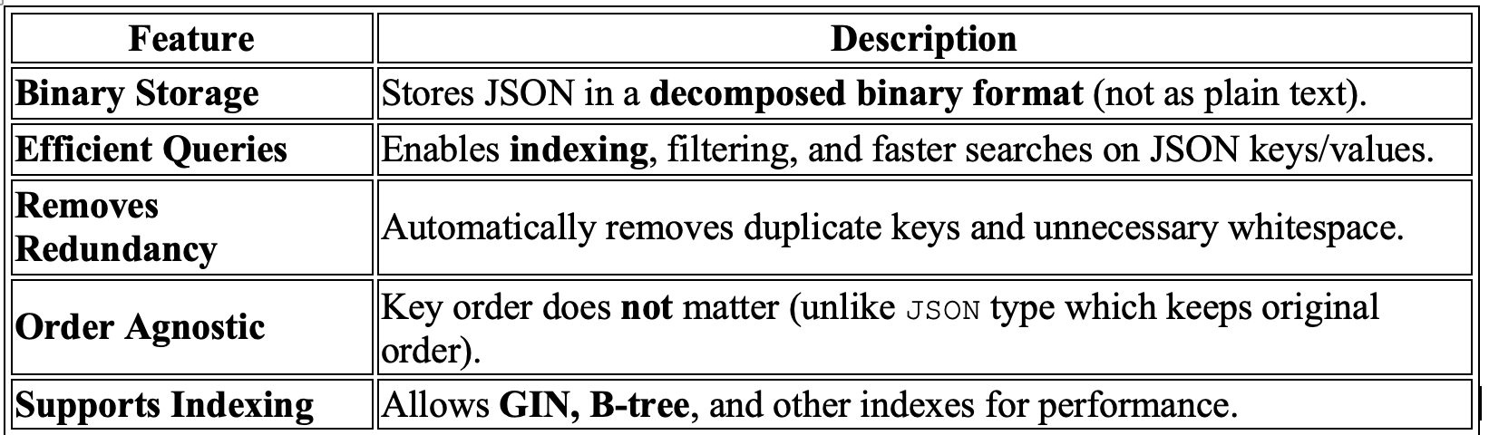
JSONb
JSONB (short for JSON Binary) is a data type in PostgreSQL that stores JSON
(JavaScript Object Notation) data in a binary format for faster processing and querying.
ideal for applications that require quick access to structured information

Slide 57
Create table using JsonB
CREATE TABLE appuser (
id SERIAL PRIMARY KEY,
name TEXT NOT NULL,
email TEXT UNIQUE NOT NULL,
profile JSONB
);
INSERT INTO appuser (name, email, profile)
VALUES (
'Bob Ray',
'bob@example.com',
'{"department": "IT", "level": 2}'::jsonb
);

Slide 58

Built-in Functions - JSON/JSONB Functions in PostgreSQL
Function/Operator | Description | Example | Result
-> | Get JSON object field by key (as JSON) | data->'name' | "John"
->> | Get field as text | data->>'name' | John
#> | Get nested JSON object | data#>'{address,city}' | "Mumbai"
#>> | Get nested field as text | data#>>'{address,city}' | Mumbai
jsonb_each() | Expands object to key-value rows | jsonb_each(data) | key/value pairs
jsonb_array_elements() | Expands JSON array to rows | jsonb_array_elements(data->'skills') | Each skill

Slide 59
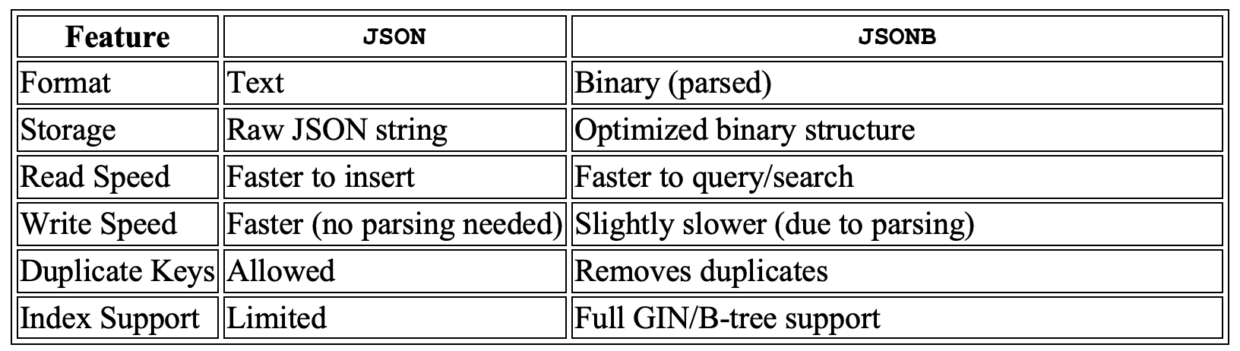
JSON vs JSONb

Slide 60
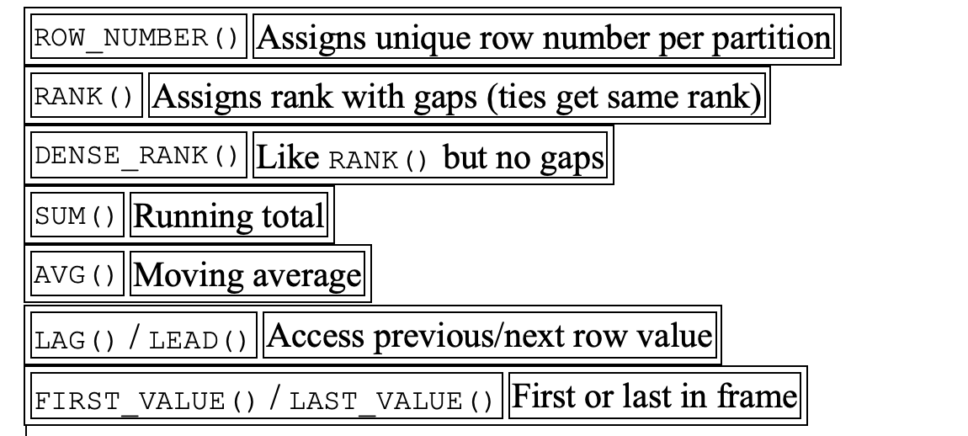
Window Functions
Window functions perform calculations across rows related to the current row without collapsing the result set (unlike GROUP BY).

Slide 61
Windows - RANK employees by salary in each department
SELECT emp_name, dept_id, salary,
RANK() OVER (PARTITION BY dept_id ORDER BY salary DESC) AS rank_in_dept
FROM employees;

Slide 62
Window- Calculate average salary in each department along with individual salary
SELECT emp_name, dept_id, salary,
AVG(salary) OVER (PARTITION BY dept_id) AS avg_salary_dept
FROM employees;

Slide 63
Window: Row number of each employee based on hire date
SELECT emp_name, hire_date,
ROW_NUMBER() OVER (ORDER BY hire_date ASC) AS row_num_by_hire_date
FROM employees;

Slide 64
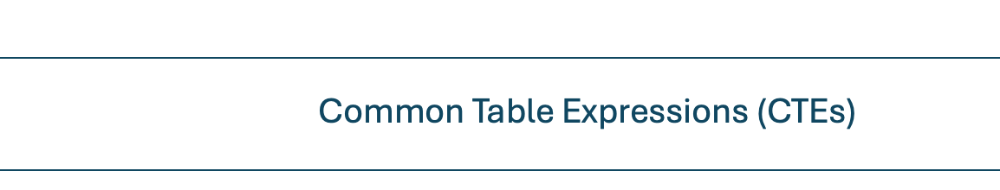
CTE- Common Table Expressions (CTEs)
A CTE is a temporary result set defined using WITH that can be referred to within a SELECT,
INSERT, UPDATE, or DELETE.
Get employees with above-average salary using CTE
WITH avg_salary_cte AS (
SELECT AVG(salary) AS avg_sal
FROM employees
)
SELECT emp_name, salary
FROM employees, avg_salary_cte
WHERE employees.salary > avg_salary_cte.avg_sal;

Slide 65

Security and Access Control
Authentication
Determines who can connect.
Controlled via the pg_hba.conf file.
CREATE ROLE analyst LOGIN PASSWORD 'securepass';
GRANT CONNECT ON DATABASE companydb TO analyst;

Slide 66
Privileges and GRANT/REVOKE
GRANT SELECT ON employees TO analyst;
REVOKE UPDATE ON employees FROM analyst;

Slide 67
Row-Level Security (RLS)
Enable RLS
ALTER TABLE employees ENABLE ROW LEVEL SECURITY;
-- Create a policy
CREATE POLICY emp_policy
ON employees
FOR SELECT
USING (emp_id = current_user::int);

Slide 68
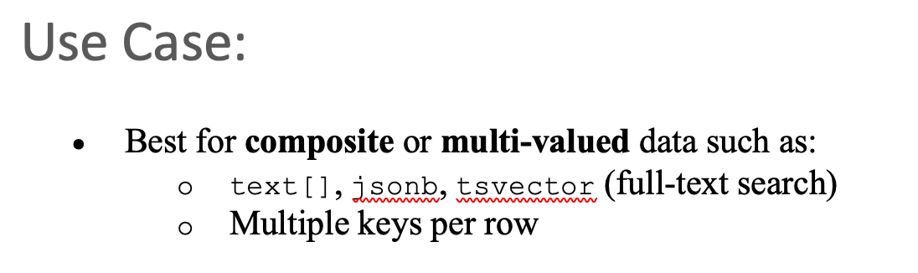
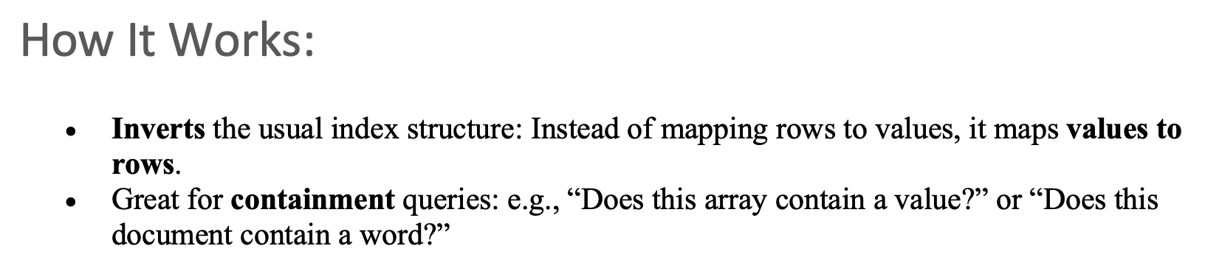
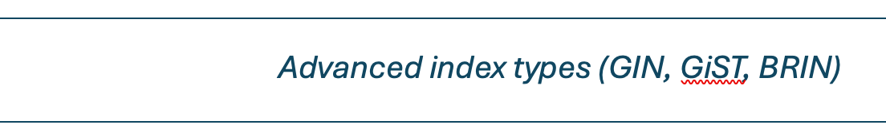
Advanced index types (GIN, GiST, BRIN)
There are advanced index types designed to handle complex data types and large-scale datasets more efficiently.

Slide 69
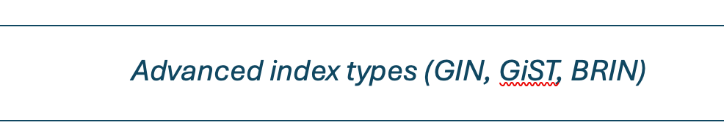
What is GIN?
GIN (Generalized Inverted Index) is a special type of index in PostgreSQL designed for indexing composite values like:
jsonb
arrays
tsvector (full-text search)
hstore

Slide 70
Why GIN?
When your column contains multiple elements (like key-value pairs or list of words), a B-tree index isn’t efficient.
GIN indexes each individual element inside the column, making lookups and searches fast.
CREATE TABLE products (
product_id SERIAL PRIMARY KEY,
name TEXT,
attributes JSONB
);
CREATE INDEX idx_gin_attributes ON products USING GIN (attributes);
SELECT * FROM products WHERE attributes @> '{"brand": "Dell"}';

Slide 71
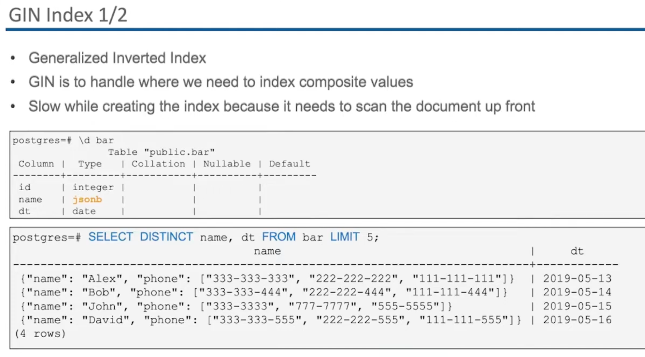
GIN
GIN stands for Generalized Inverted Index. It’s a special type of index in PostgreSQL used to efficiently search composite values such as:
jsonb fields
arrays
tsvector (full-text search)
range types

Slide 72
GIN vs B-tree:
Feature | GIN | B-tree
Use Case | Multiple values (JSONB, arrays) | Scalar values (int, text)
Index Build | Slower | Faster
Lookup Speed | Faster for complex queries | Slower on nested fields
Disk Usage | Higher | Lower

Slide 73
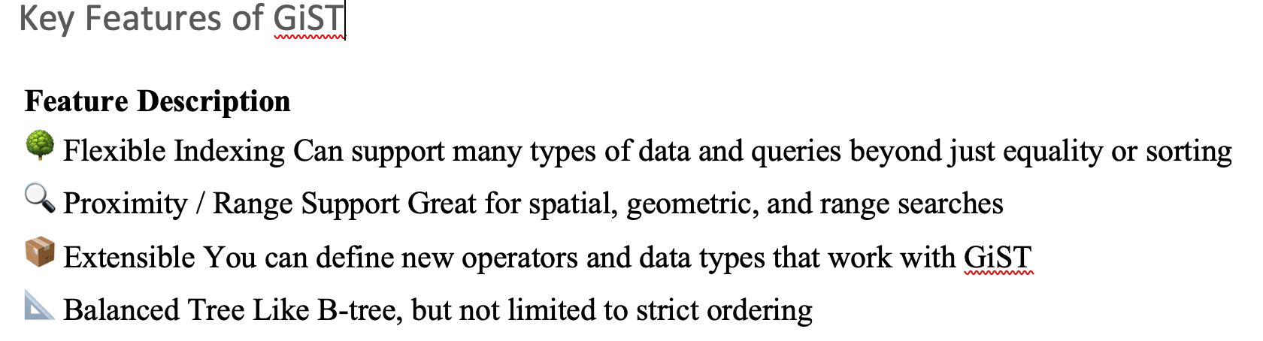
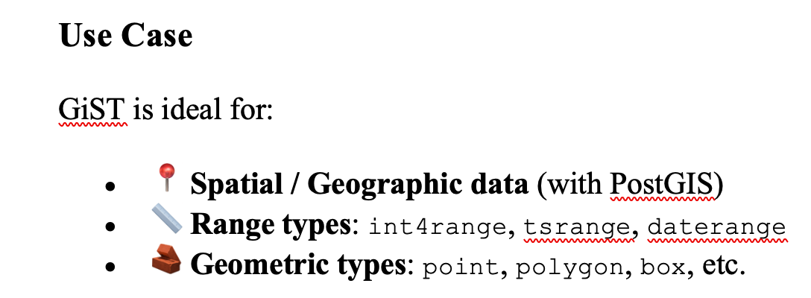
GIST
GiST stands for Generalized Search Tree. It is a flexible, balanced tree index structure in PostgreSQL used to support advanced, non-standard queries — especially for complex data types

Slide 74
GIST
CREATE TABLE bookings (
id SERIAL,
room_id INT,
availability DATERANGE
);
CREATE INDEX idx_gist_availability
ON bookings USING GIST(availability);

Slide 75
BRIN
BRIN (Block Range Index) is a special type of index in PostgreSQL that is designed for very large, naturally ordered tables — such as log data, time-series, or sensor readings.
What Is BRIN?
BRIN indexes store summary information about blocks of rows, not individual rows.
They are small and fast to build, and very space-efficient.
Best when your data is physically ordered on disk (e.g., by date or timestamp).

Slide 76
BRIN
How It Works?
PostgreSQL divides the table into blocks (usually 8KB per block).
A BRIN index stores:
The minimum and maximum value for each block.
During queries, PostgreSQL uses this to skip blocks that can't possibly match the condition.

Slide 77
When to use BRIN?
Use Case | Why BRIN Works Best
Append-only tables | Rows are inserted in order (e.g., logs, events)
Time-series data | Indexed column is increasing (e.g., timestamp)
Very large tables | Millions or billions of rows

Slide 78
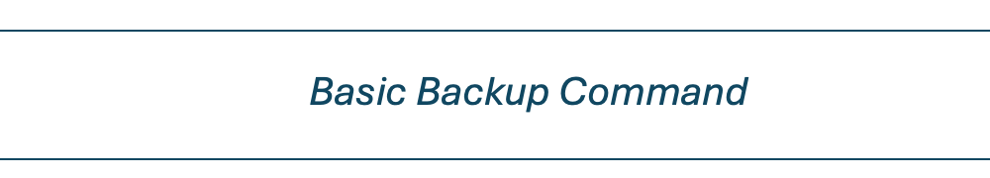
Basic Backup Command
Why Backup?
Backing up your database ensures you can:
Recover from accidental data loss or corruption.
Restore data to a specific state.
Move data between systems or environments.

Slide 79
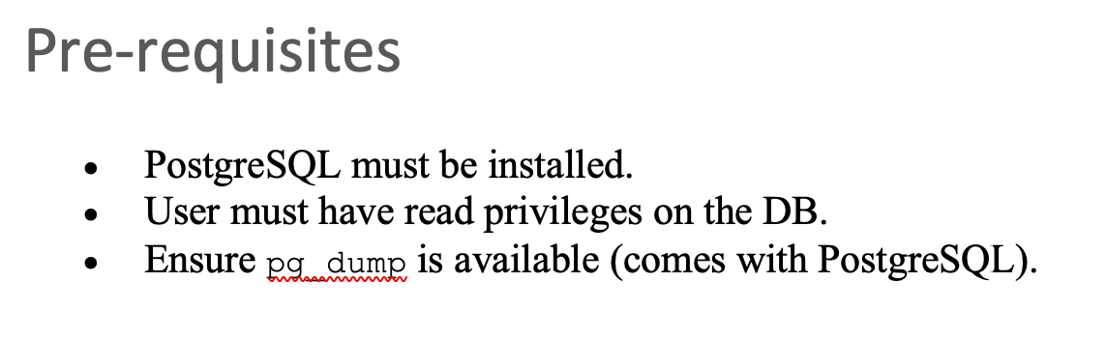
What is pg_dump?
A PostgreSQL utility to export a database into a .sql or compressed file.
Creates logical backups (schema + data).

Slide 80
Basic Backup command
Quit from postgres
pg_dump -U postgres -d test > test-backup.sql
-U User name
-d Database name
> Redirect output to file
Validate it ls –l test-backup.sql

Slide 81
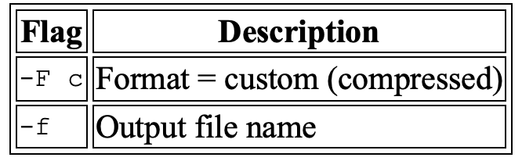
Backup with Custom Format (Compressed)
pg_dump -U postgres -F c -f mydb_backup.dump mydb

Slide 82
Restoring from SQL File
psql -U postgres -d newdb < mydb_backup

Slide 83
4. Restoring from Custom Dump
psql -U postgres -d test -f ~/Documents/test_backup.sql
pg_restore -U postgres -d newdb mydb_backup.dump

Slide 84
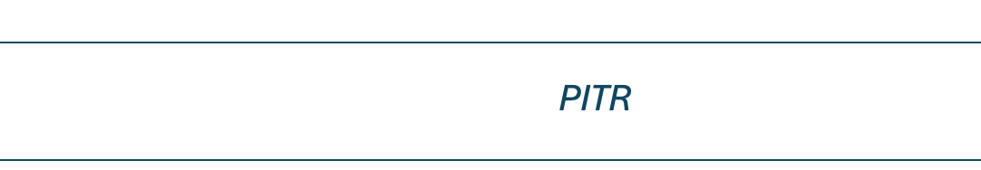
PITR - Point-In-Time Recovery (PITR) – WAL-based Physical Backup
What is PITR?
Restores the database to any point in time using:
Base physical backup (with pg_basebackup)
WAL (Write-Ahead Log) files

Slide 85
PITR Use Case
Let’s say you:
Accidentally deleted important data at 5:15 PM.
Have a full base backup from 4:00 PM and continuous write-ahead log (WAL) files.
With PITR, you can restore the database to just before 5:15 PM (e.g., 5:14:59 PM) — like time trav

Slide 86
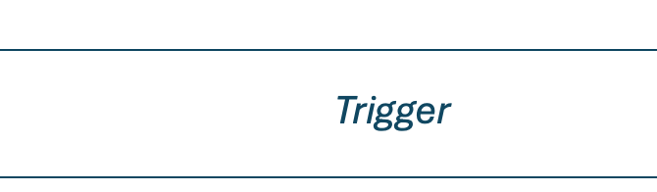
Trigger
A trigger in PostgreSQL is a database callback function that automatically executes in response to a specific event on a table or view.

Slide 87


Why write PL/pgSQL Functions
Reusable logic
Return types: scalar or table

Slide 88
Writing Simple PL/pgSQL Functions
Example of writing PL/pgSQL function
CREATE FUNCTION add(a INT, b INT)
RETURNS INT AS $$
BEGIN
RETURN a + b;
END;
$$ LANGUAGE plpgsql;
Function name
Procedure being
Return value / type
Executable statements
Procedure ends

Slide 89
What is a Trigger?
A trigger is a piece of code that automatically runs when a specific event happens on a table.
Use Case | Description
Audit logs | Track who changed what and when
Data validation | Enforce custom business rules
Auto-updates | Automatically update related fields (e.g., timestamps)
Notifications | Send alerts when data changes

Slide 90
Types of Trigger condition
1
BEFORE – Runs before the row is inserted/updated/deleted
2
AFTER – Runs after the row is changed
3
INSTEAD OF – Used with views
Sample query to set trigger
CREATE TRIGGER log_update
AFTER UPDATE ON employees
FOR EACH ROW
EXECUTE FUNCTION audit_func();
Trigger name
Trigger name
Trigger Condition
Function name

Slide 91

Transaction Control
BEGIN
Start transaction
COMMIT
Save changes
ROLLBACK
Undo changes on failure
SUCESS
COMMIT
TRANSACTIONS
Initial State
BEGIN
DATABASE
FAIL
ROLLBACK

Slide 92


Managing Roles
Create User/Role:
CREATE ROLE analyst LOGIN PASSWORD 'pass';
Assign privileges:
GRANT SELECT ON employees TO analyst;
SELECT grantee, privilege_type
FROM information_schema.role_table_grants
WHERE table_name = 'employees' AND grantee = 'analyst';

Slide 93


GRANT & REVOKE Syntax
Use roles for groups to simplify permission management
GRANT INSERT, UPDATE ON employees TO hr_role;
REVOKE DELETE ON employees FROM hr_role;

Slide 94
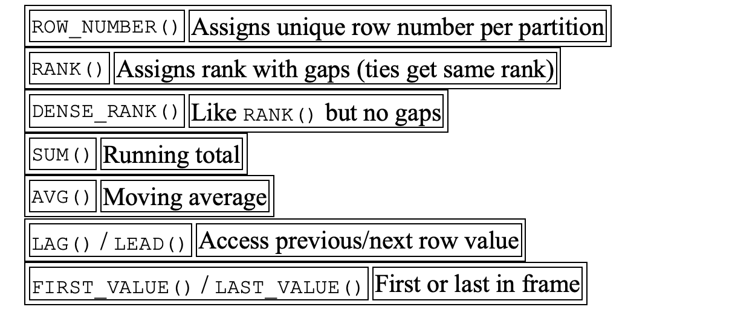
Windows Function
Window functions perform calculations across rows related to the current row without collapsing the result set (unlike GROUP BY).

Slide 95
Windows - Rank
SELECT emp_name, dept_id, salary,
RANK() OVER (PARTITION BY dept_id ORDER BY salary DESC) AS rank_in_dept
FROM employees;
SELECT emp_name, dept_id, salary,
AVG(salary) OVER (PARTITION BY dept_id) AS avg_salary_dept
FROM employees;

Slide 96
Windows - Next
SELECT emp_name, dept_id, salary,
LEAD(salary, 1) OVER (PARTITION BY dept_id ORDER BY salary) AS next_salary
FROM employees;

Slide 97
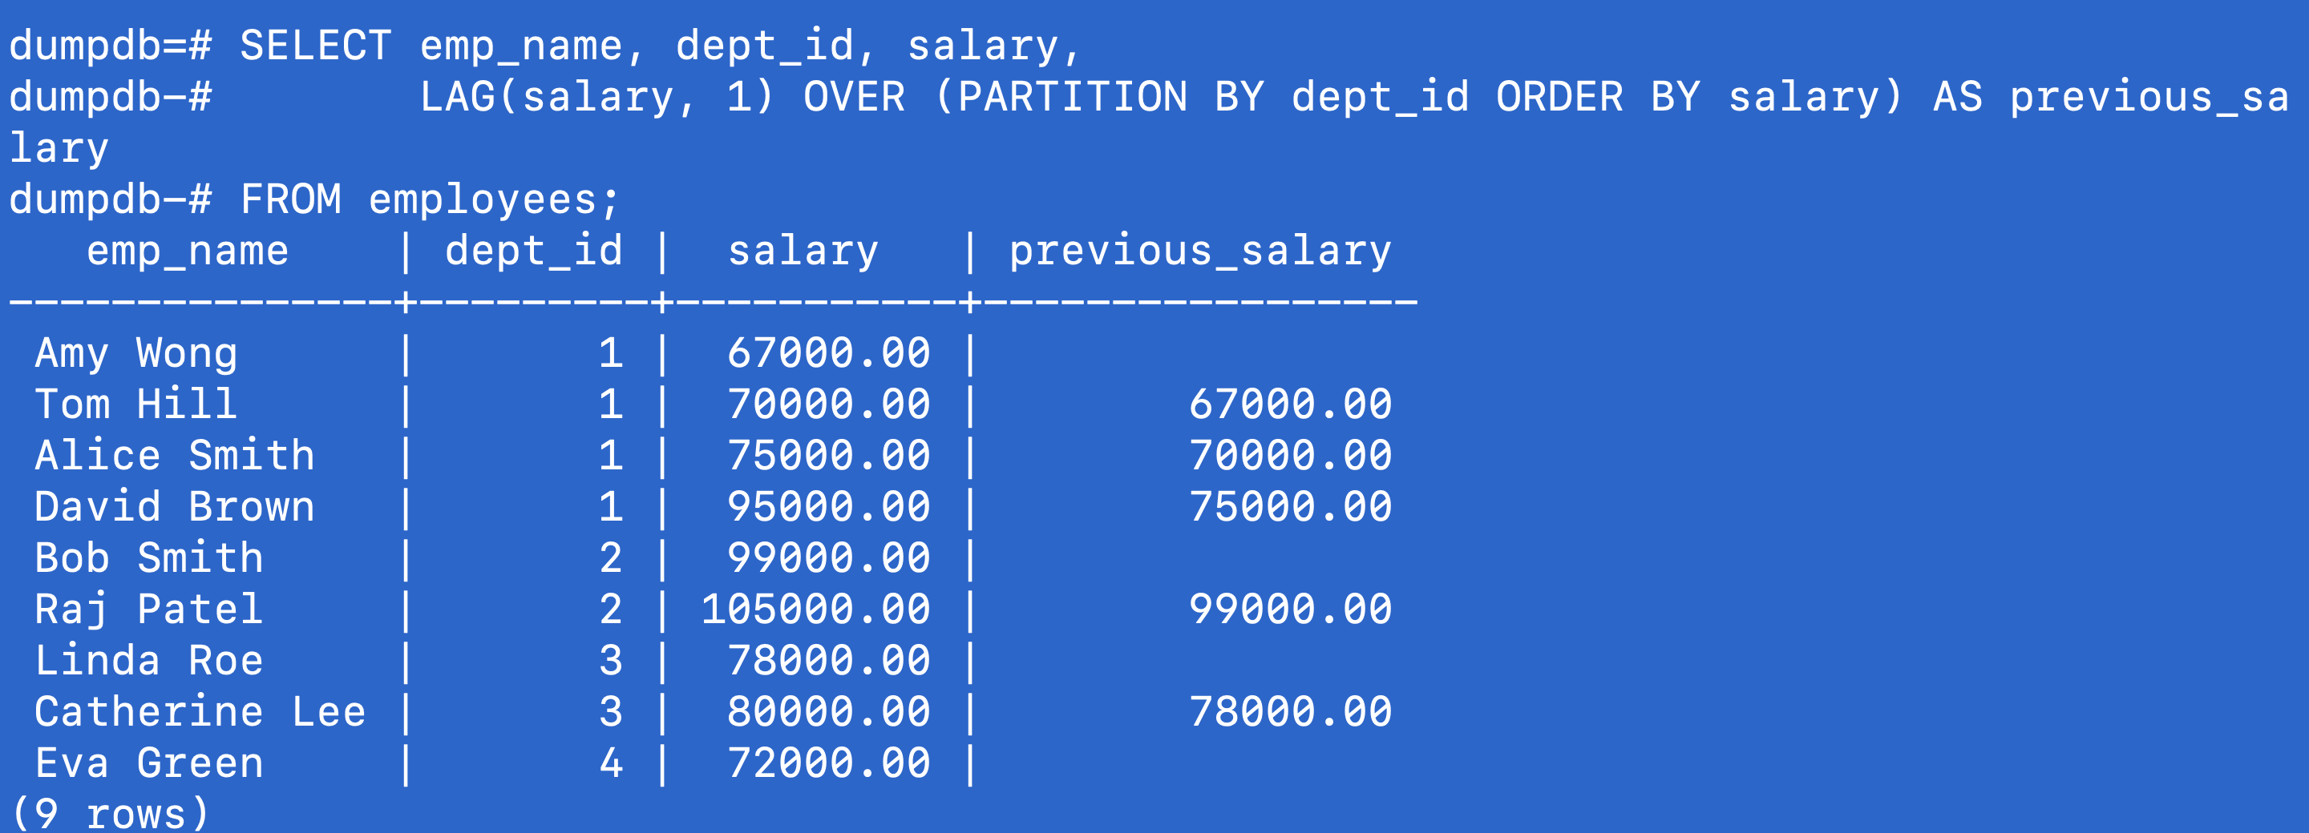
Windows - LAG
SELECT emp_name, dept_id, salary,
LAG(salary, 1) OVER (PARTITION BY dept_id ORDER BY salary) AS previous_salary
FROM employees;

Slide 98
Transaction
BEGIN , Commit, Rollback
CREATE TABLE staff (
emp_id SERIAL PRIMARY KEY,
emp_name VARCHAR(50),
salary NUMERIC
);
INSERT INTO staff (emp_name, salary)
VALUES ('Alice', 50000),('Bob', 60000),('Charlie', 70000);

Slide 99
Transaction
ROLLBACK
-- Start another transaction
BEGIN;
-- Try updating Alice’s salary
UPDATE staff SET salary = 100000 WHERE emp_name = 'Alice';
-- Oops! Realized it was a mistake
ROLLBACK;
SELECT * FROM staff;

Slide 100
Transaction
Example -Savepoint
-- Start the transaction
BEGIN;
-- Step 1: Give Charlie a raise
UPDATE staff SET salary = salary + 10000 WHERE emp_name = 'Charlie';
-- Set savepoint here
SAVEPOINT after_charlie_raise;
-- Step 2: Try to give Bob a huge raise (assume this is a mistake)
UPDATE staff SET salary = salary + 500000 WHERE emp_name = 'Bob';
-- Realize the mistake and rollback to savepoint
ROLLBACK TO SAVEPOINT after_charlie_raise;
-- Now Bob's raise is undone, but Charlie's raise is still there
-- Commit changes so far
COMMIT;

Slide 101
Advanced Index

Slide 102
Survey Link

Slide 103
New York Restaurants:

Slide 104
Trends in Startups

Slide 105
Create a Table

Slide 106
Book Store Indexes

Slide 107
Traffic Analytics

Slide 108
Data Exchange Service

Slide 109
Database Normalization

Slide 110
Book Store Indexes

